Slide 1
CAOS Project - HacOSsim
Fabio Lorenzato (332186) - Alessandro Milani (s332136) - Matteo Scrusatone (332153)

Slide 2

Real-Time Operating System
The extensive documentation available
A really active forum
That one being open source, of course
Prior knowledge of it could be useful in the future, because it’s backed by Amazon

Slide 3
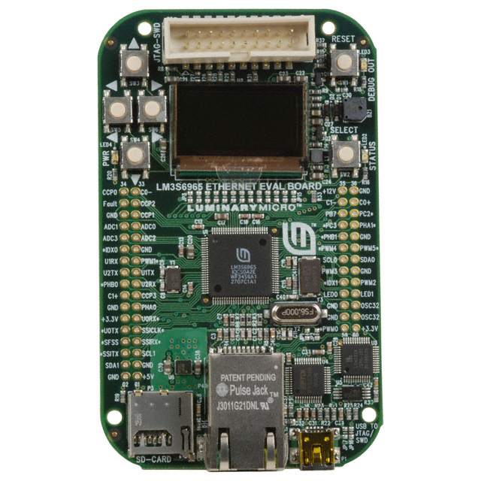
Board & Emulator
We emulated the Luminary Micro Stellaris LM3S6965EVB thanks to Qemu.
This board has some interesting feature like:
256k Flash memory and 64k SRAM
Lots of featured and interfaces available (Timers, UARTs, ADC, I2C, SSI interfaces, . . . )
Some graphical drivers already available
lots of guided examples

Slide 4
Display Demo
Functionalities implemented:
HW
Display
SW
Semaphore
message queue

Slide 5
Input Demo
Functionalities implemented:
HW
UART device
SW
Keyboard input function

Slide 6
CHAOS demo
Other implementation:
SW
More task that have access to the display simultaneously
Bitmap
Pseudo Random Generator

Slide 7
Pong
Funny to play until you comprehend that you cannot win.

Slide 8
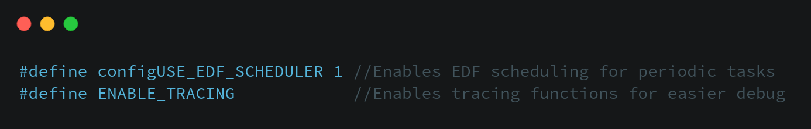
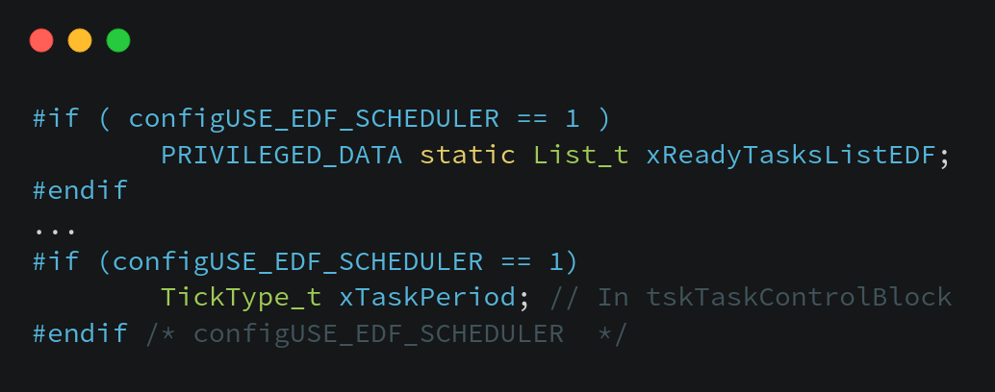
EDF implementation
New scheduler has to be enabled.
New ready list to handle tasks, made possible by adding the period to the Task PCB.

Slide 9
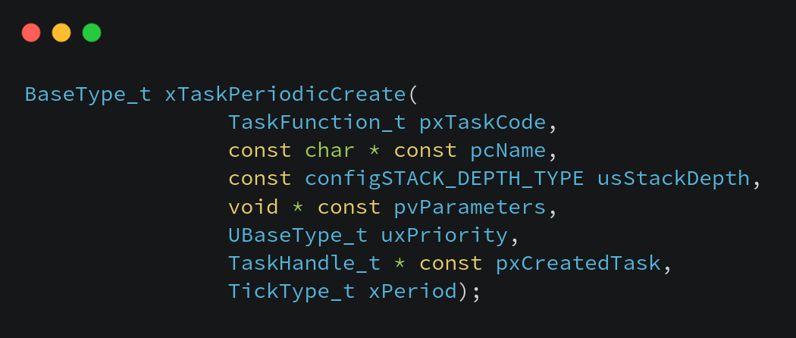
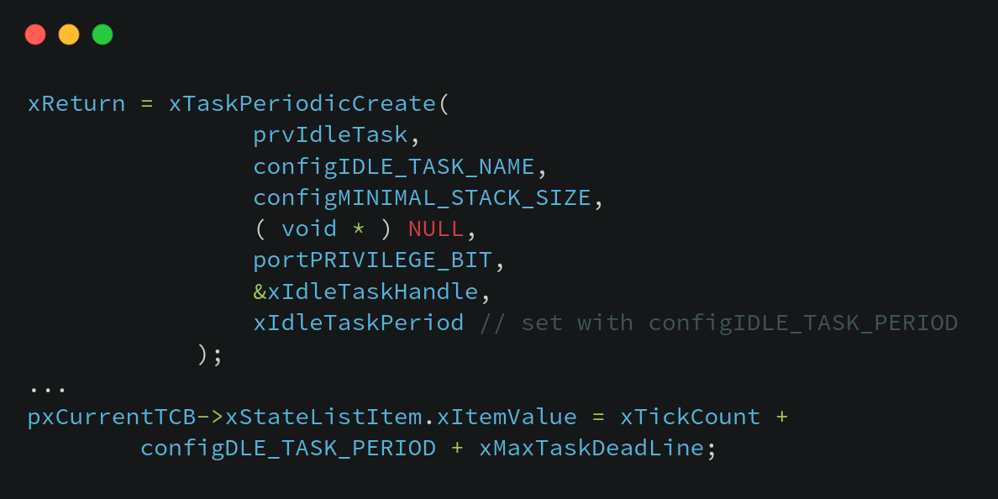
EDF implementation
New way to create tasks(period instead of priority).
Idle task became periodic, which will never run unless it’s necessary.

Slide 10
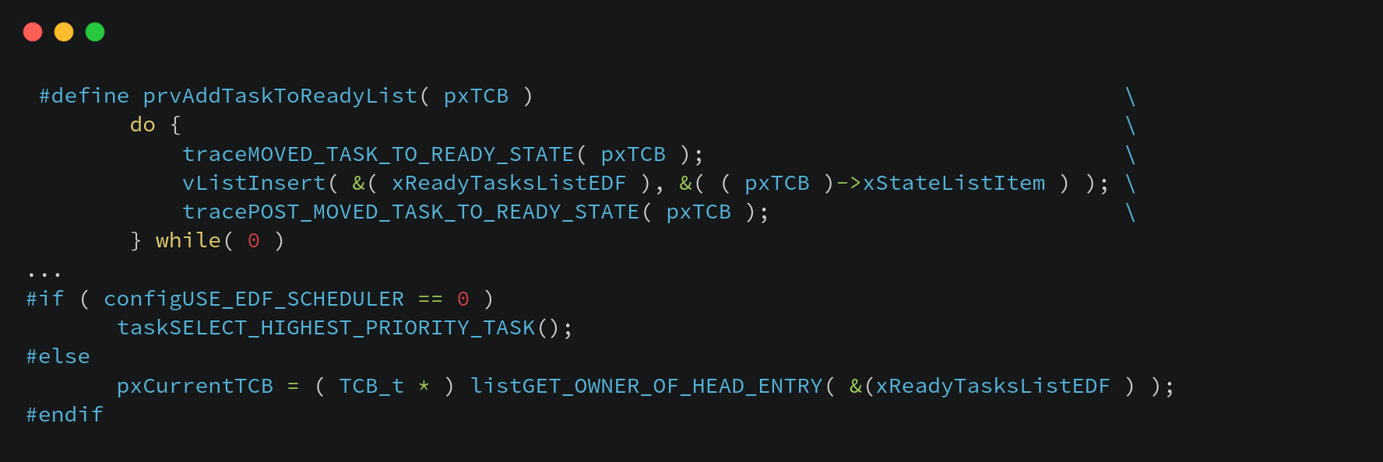
EDF implementation
Changed the logic for context switch.

Slide 11
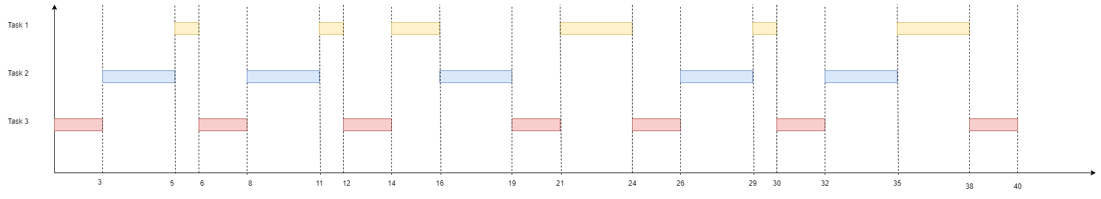
EDF Performance Evaluation
 | Task period | Execution time
Task 1 | 40 | 11
Task 2 | 8 | 3
Task 3 | 6 | 2

Slide 12
EDF benchmark
Effectiveness:
42.358% reduction of switch in
56.311% reduction of idle ticks
More balanced overall lateness
 | Default | EDF
Idle ticks | 103 | 58
Switch in | 1289 | 546
Lateness Task 1 | -13.93 | -6.31
Lateness Task 2 | -1.47 | -4.32
Lateness Task 3 | -1.57 | -4.0
*All results in ticks

Slide 13
Project contribution
Task | Lorenzato | Milani | Scursatone
Repo setup and configuration | X | X | X
Demo code implementation | X | X | X
Scheduling algorithm implementation | X
Performance evaluation | X | X
Report and Documentation | X | X | X

Slide 14
Thanks for your attention!

